Slide 1

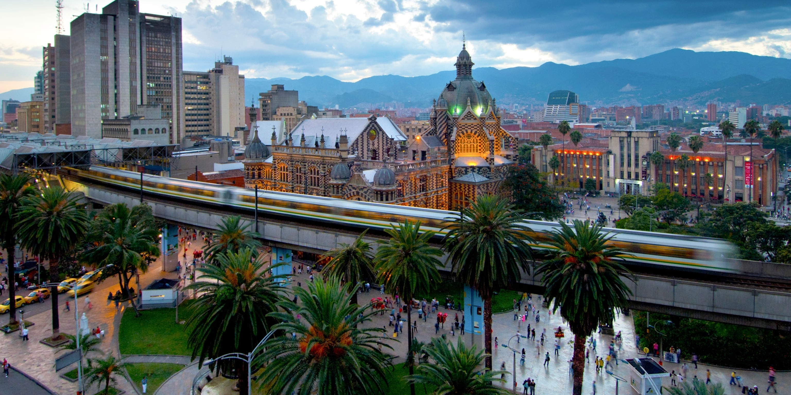
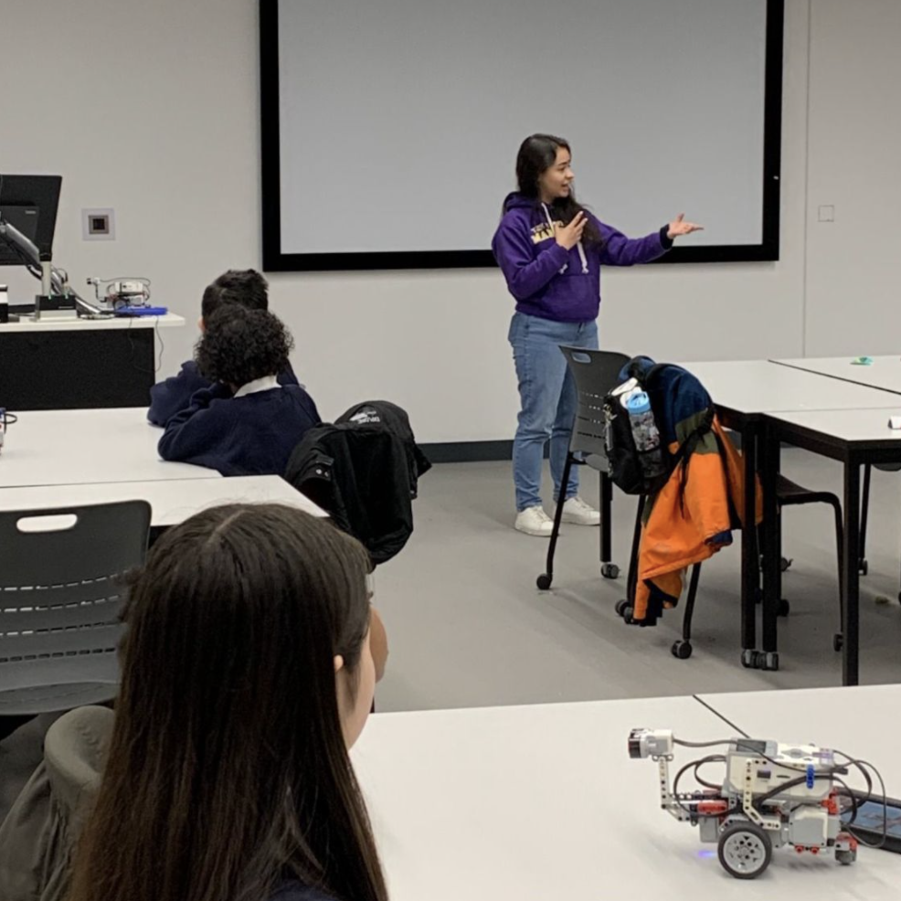

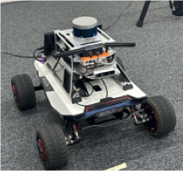

Diana C. Benjumea Hernández
Who am I? :
PhD candidate in Computer Science at The University of Manchester.
Interested in:
Robotic Autonomous Systems,
Software Verification,
Software Architectures,
Safety-critical Computer Systems
BDI Programming Languages.
Why am I here?
To learn, collaborate, and generate ideas.

Slide 2
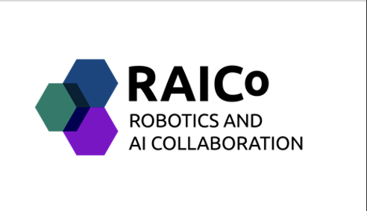
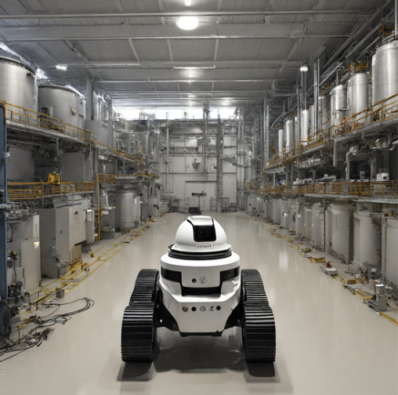
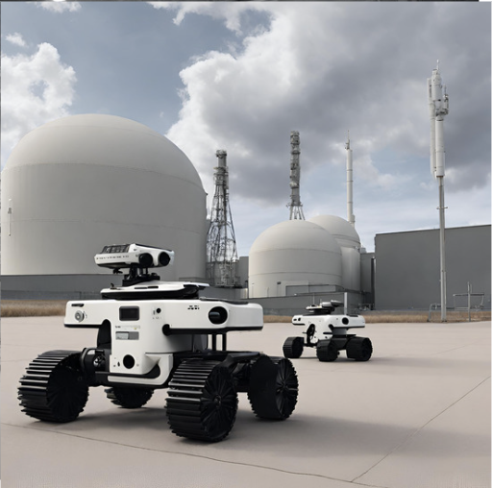
What is my research about?
RESEARCH PROBLEM
Ensure the safe operation of Robotic Autonomous Systems (RAS).
USE CASE
UK nuclear safety regime.
RESEARCH GOAL
Develop a systematic approach that demonstrates the feasibility of deploying RAS in the nuclear environment while ensuring that the operational risk is tolerable and As Low As Reasonably Practicable (ALARP) ^{[1]}.
1. Office for Nuclear Regulation (ONR). Guidance on the demonstration of ALARP (as low as reasonably practicable). Nuclear Safety Technical Assessment Guide NS-TAST-GD-005.

Slide 3

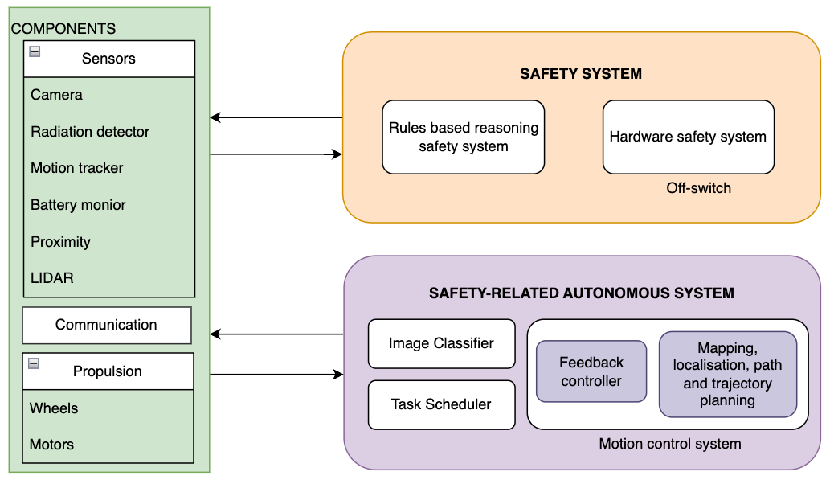
Research approach
(Control system)
Fig. Autonomous System Architecture. The proposed approach extends a previous study^{[1]}, that introduced a method for an intelligent control system to detect collisions in a hypothetical robot surveying a nuclear waste storage facility.
1. Anderson, C. R., & Dennis, L. A. (2023). Autonomous Systems' Safety Cases for use in UK Nuclear Environments. arXiv preprint arXiv:2310.02344.

Slide 4




diana.benjumeahernandez@manchester.ac.uk
Keep in touch!
Scan me

